Slide 1
Loadable Kernel Modules
Dzintars Lepešs
The University of Latvia

Slide 2
Overview
What is a loadable kernel module
When to use modules
Intel 80386 memory management
How module gets loaded in proper location
Internals of module
Linking and unlinking module

Slide 3
Kernel module description
To add a new code to a Linux kernel, it is necessary to add some source files to kernel source tree and recompile the kernel. But you can also add code to the Linux kernel while it is running. A chunk of code added in such way is called a loadable kernel module
Typical modules:
  device drivers
  file system drivers
  system calls

Slide 4
When kernel code must be a module
higher level component of Linux kernel can be compiled as modules
some Linux kernel code must be linked statically then component is included in the kernel or it is not compiled at all
Basic Guideline
Build working base kernel, that include anything that is necessary to get the system up, everything else can be built as modules

Slide 5
Advantages of modules
There is no necessity to rebuild the kernel, when a new kernel option is added
Modules help find system problems (if system problem caused a module just don't load it)
Modules save memory
Modules are much faster to maintain and debug
Modules once loaded are inasmuch fast as kernel

Slide 6
Module Implementation
Modules are stored in the file system as ELF object files
The kernel makes sure that the rest of the kernel can reach the module's global symbols
Module must know the addresses of symbols (variables and functions) in the kernel and in other modules (/proc/syms <2.6 /proc/kallsyms - 2.6)
The kernel keeps track of the use of modules, so that no modules is unloaded while another module or kernel is using it (/proc/modules)

Slide 7
Module Implementation
The kernel considers only modules that have been loaded into RAM by the insmod program and for each of them allocates memory area containing:
  a module object
  null terminated string that represents module's name
  the code that implements the functions of the module

Slide 8
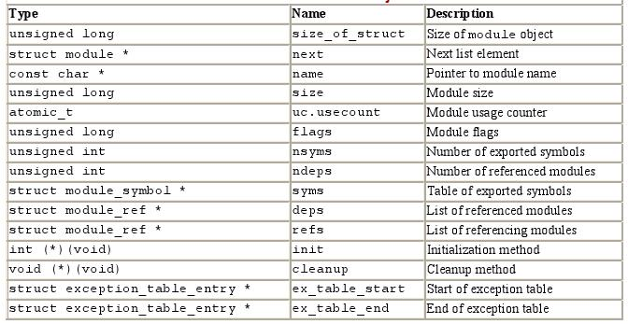
Module Object

Slide 9
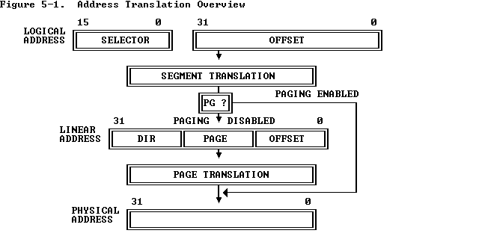
80386 Memory Management

Slide 10
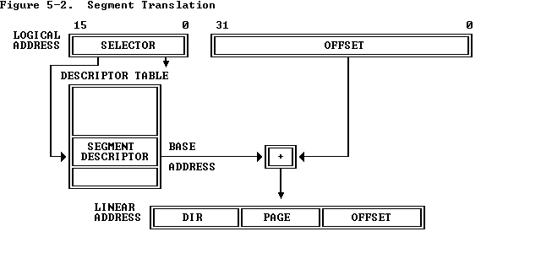
Segment Translation

Slide 11
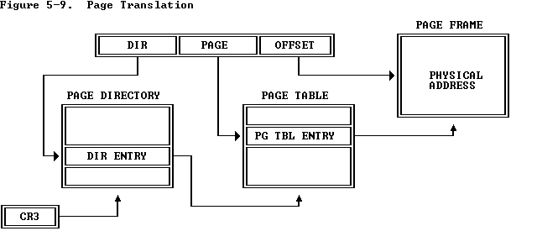
Page Translation

Slide 12
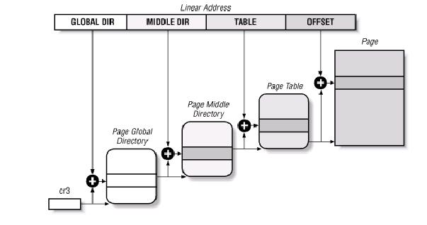
Linux paging model

Slide 13
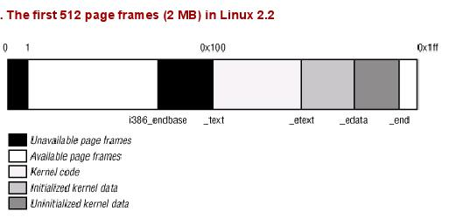
Reserved Page Frames

Slide 14
Kernel Page Tables
Provisional kernel page tables – first phase
The Page Global Directory and Page table are initialized statically during the kernel compilation. During this phase of initialization kernel can address the first 4MB either with or without paging.
Final kernel page table – second phase
transforms linear addresses starting from PAGE_OFFSET into physical addressing starting from 0

Slide 15
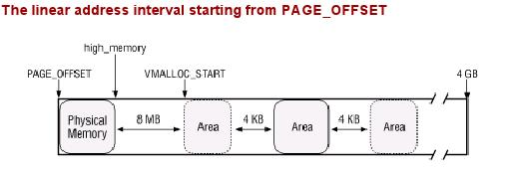
Noncontiguous Memory Area Management
free range of linear addresses are located in the area starting from PAGE_OFFSET (usually the beginning of fourth gigabyte). Kernel reserves whole upper area of memory, but uses only a small fraction of the gigabyte.

Slide 16
Allocating a Noncontiguous Memory Area
The vmalloc( ) function allocates a noncontiguous memory area to the kernel. If the function is able to satisfy the request, then it returns the initial linear address of the new area; otherwise, it returns a NULL pointer
The function then uses the pgd_offset_k macro to derive the entry in the Page Global Directory related to the initial linear address of the area

Slide 17
Allocating a Noncontiguous Memory Area
The function then executes the cycle, in which :
  it first creates a Page Middle Directory for the new area.
  then it allocates all the Page Tables associated with the new Page Middle Directory.
  then, it updates the entry corresponding to the new Page Middle Directory in all existing Page Global Directories
  then it adds the constant 2²², that is, the size of the range of linear addresses spanned by a single Page Middle Directory, to the current value of address
  repeated until all page table have been set up.

Slide 18
Releasing a Noncontiguous Memory Area
noncontiguous memory areas releases the vfree( ) function.
for (p = &vmlist ; (tmp = *p) ; p = &tmp->next) {
if (tmp->addr == addr) {
*p = tmp->next;
vmfree_area_pages((unsigned long)(tmp->addr),
tmp->size);
kfree(tmp);
return;
}
}

Slide 19
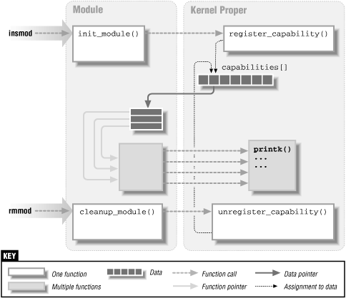
Linking and Unlinking Modules

Slide 20
Programs for linking and unlinking
insmod
  Reads from the name of the module to be linked
  Locates the file containing the module's object code
  Computes the size of the memory area needed to store the module code, its name, and the module object
  Invokes the create_module( ) system call
  Invokes the query_module( ) system call
  Using the kernel symbol table, the module symbol tables, and the address returned by the create_module( ) system call, relocates the object code included in the module's file.
  Allocates a memory area in the User Mode address space and loads with a copy of the module object
  Invokes the init_module( ) system call, passing to it the address of the User Mode memory area
  Releases the User Mode memory area and terminates

Slide 21
Programs for linking and unlinking
lsmod
reads /proc/modules
rmmod
  From reads the name of the module to be unlinked.
  Invokes the query_module( )
  Invokes the delete_module( ) system call, with the QM_REFS subcommand several times, to retrieve dependency information on the linked modules.
modprobe
  takes care of possible complications due to module dependencies, uses depmod program and /etc/modules.conf file

Slide 22
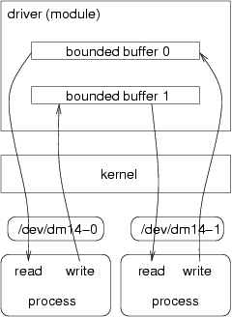
Device drivers
There are two major ways for a kernel module to talk to processes:
    To use the proc file system (/proc directory)
    Through device files (/dev directory)
Device driver sits between some hardware and the kernel I/O subsystem. Its purpose is to give the kernel a consistent interface to the type of hardware it "drives".

Slide 23
Compiling kernel module
A kernel module is not an independent executable, but an object file which will be linked into the kernel in runtime and they should be compiled with
  -c flag
  _KERNEL_ symbol
  MODULE symbol
  LINUX symbol
  CONFIG_MODVERSIONS symbol

Slide 24
Example of simple char device
/* The necessary header files */
/* Standard in kernel modules */
#include <linux/kernel.h> /* We’re doing kernel work */
#include <linux/module.h> /* Specifically, a module */
#if CONFIG_MODVERSIONS==1
#define MODVERSIONS
#include <linux/modversions.h>
#endif
#include <linux/fs.h>
#include <linux/wrapper.h>
#ifndef KERNEL_VERSION
#define KERNEL_VERSION(a,b,c) ((a)*65536+(b)*256+(c))
#endif
#if LINUX_VERSION_CODE > KERNEL_VERSION(2,2,0)
#include <asm/uaccess.h>
#endif
#define SUCCESS 0
/* Device Declarations */
/* The name for our device, as it will appear
/* in /proc/devices */
#define DEVICE_NAME "char_dev"
#define BUF_LEN 80

Slide 25
/* Used to prevent */
/* concurent access into the same device */
static int Device_Open = 0;
/* The message the device will give when asked */
static char Message[BUF_LEN];
static char *Message_Ptr;
/* This function is called whenever a process
* attempts to open the device file */
static int device_open(struct inode *inode,
struct file *file)
{
static int counter = 0;
#ifdef DEBUG
printk ("device_open(%p,%p)\n", inode, file);
#endif
printk("Device: %d.%d\n“,
inode->i_rdev >> 8, inode->i_rdev & 0xFF);
if (Device_Open)
return -EBUSY;
Device_Open++;
sprintf(Message,
counter++,
Message_Ptr = Message;
MOD_INC_USE_COUNT;
return SUCCESS;
}

Slide 26
if (Device_Open)
return -EBUSY;
Device_Open++;
sprintf(Message,
counter++,
Message_Ptr = Message;
MOD_INC_USE_COUNT;
return SUCCESS;
}
#if LINUX_VERSION_CODE >=KERNEL_VERSION(2,2,0)
static int device_release(struct inode *inode,
struct file *file)
#else
static void device_release(struct inode *inode,
struct file *file)
#endif
{
Device_Open --;
MOD_DEC_USE_COUNT;
#if LINUX_VERSION_CODE >= KERNEL_VERSION(2,2,0)
return 0;
#endif
}

Slide 27
#if LINUX_VERSION_CODE >= KERNEL_VERSION(2,2,0)
static ssize_t device_read(struct file *file,
char *buffer, /* The buffer to fill with data */
size_t length, /* The length of the buffer */
loff_t *offset) /* Our offset in the file */
#else
static int device_read(struct inode *inode,
struct file *file,
char *buffer, /* The buffer to fill with
* the data */
int length) /* The length of the buffer
* (mustn’t write beyond that!) */
#endif
{
/* Number of bytes actually written to the buffer */
int bytes_read = 0;
/* If we’re at the end of the message, return 0
if (*Message_Ptr == 0)
return 0;
/* Actually put the data into the buffer */
while (length && *Message_Ptr) {
put_user(*(Message_Ptr++), buffer++);
length --;
bytes_read ++;
}

Slide 28
#ifdef DEBUG
printk ("Read %d bytes, %d left\n",
bytes_read, length);
#endif
return bytes_read;
}
#if LINUX_VERSION_CODE >= KERNEL_VERSION(2,2,0)
static ssize_t device_write(struct file *file,
const char *buffer, /* The buffer */
size_t length, /* The length of the buffer */
loff_t *offset) /* Our offset in the file */
#else
static int device_write(struct inode *inode,
struct file *file,
const char *buffer,
int length)
#endif
{
return -EINVAL;
}

Slide 29
/* Module Declarations */
struct file_operations Fops = {
NULL, /* seek */
device_read,
device_write,
NULL, /* readdir */
NULL, /* select */
NULL, /* ioctl */
NULL, /* mmap */
device_open,
#if LINUX_VERSION_CODE >= KERNEL_VERSION(2,2,0)
NULL, /* flush */
#endif
device_release /* a.k.a. close */
};
/* Initialize the module - Register the character device */
int init_module()
{

Slide 30
/* Register the character device */
Major = module_register_chrdev(0,
DEVICE_NAME,
&Fops);
/* Negative values signify an error */
if (Major < 0) {
printk ("%s device failed with %d\n",
"Sorry, registering the character",
Major);
return Major;
}
return 0;
}
/* Cleanup - unregister the appropriate file from /proc */
void cleanup_module()
{
int ret;
/* Unregister the device */
ret = module_unregister_chrdev(Major, DEVICE_NAME);
if (ret < 0)
printk("Error in unregister_chrdev: %d\n", ret);
}

